Slide 1

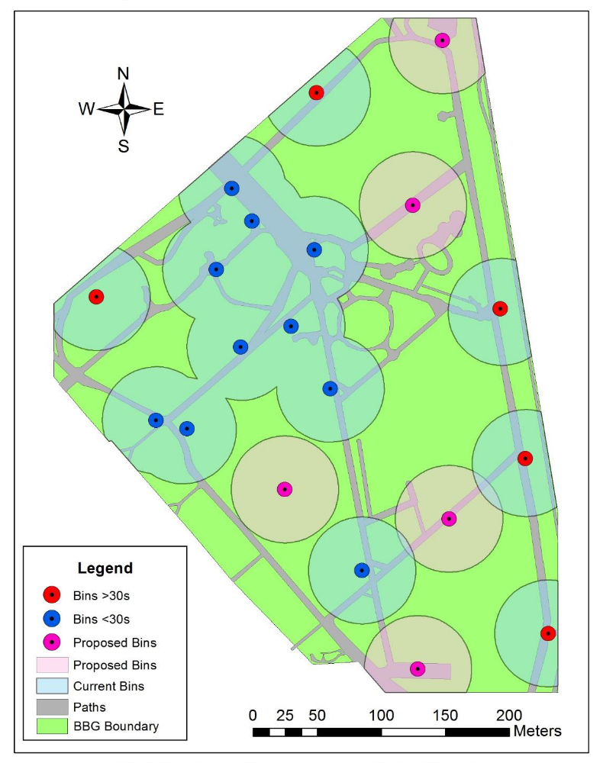
Geospatial Science Engagement
EVB203: Geospatial Information Science
Andrew Fletcher & Steven Kickbusch

Slide 2
GIS, Mobile GPS and a QUT GeoApp
Location data is highly valuable but making sense of it is priceless.
EVB203 first generation application on iPad running on Safari through SCORM (mobile iOS incompatible).
Limitations of Gen 1:
  Live data connection
  Single sign on to Blackboard
  iPad or Android (<25% of students use Android phones)
  Lost data.
Great things about Gen 1:
  970+ features in a single data set for class activities (for class, by class)
  File handling, conversion, cleaning, mapping and analyses (work ready)

Slide 3
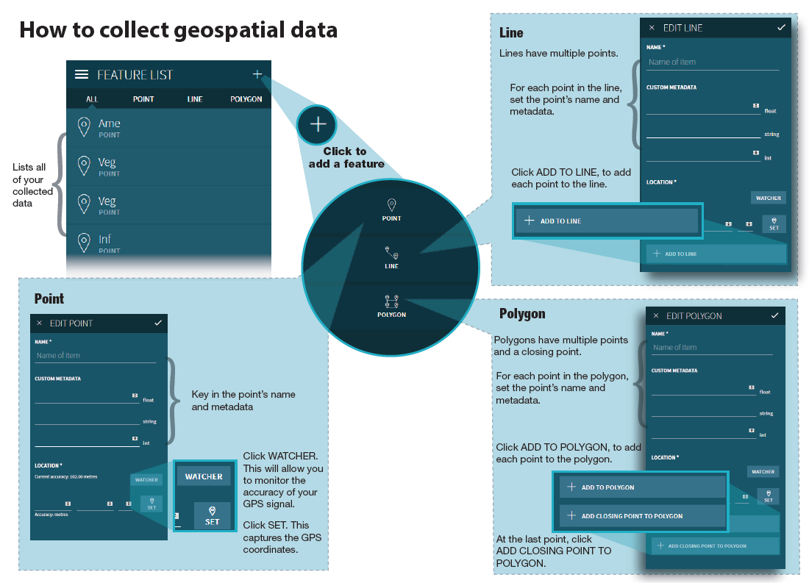
Gen1: Interface and use.
Very simple interface:
Three types of geometry
Feature list for data collected
Data link loss would only show as frozen app and lost data.

Slide 4
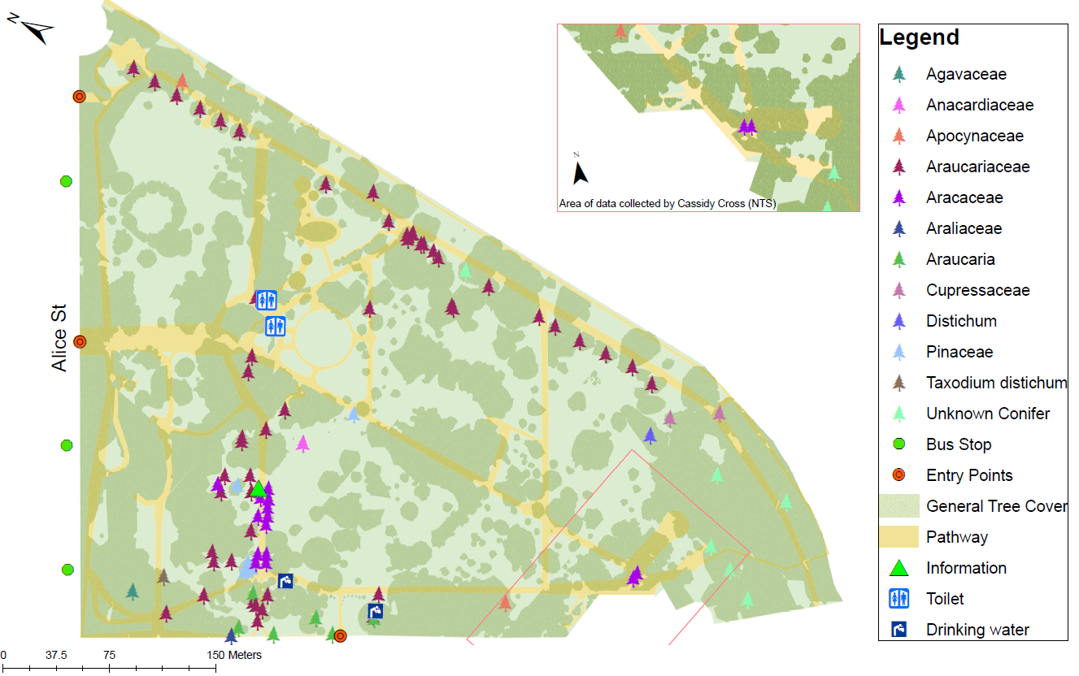
A great start
Submitted week 11 using only class data.
We need IAB330 skills to create Gen2:
  Mobile iOS compat.
  Android compat.
  Local data store.
  Easy data transfer.
  Unique ID by collector.
  Time, date, location, accuracy.
  Text, integer, float variables with man. entry.
  Higher data capture rate.

Slide 5
GeoApp Icing
Nice to haves:
  Live update map using OSM showing current location.
  Current location and collected data on map.
  Drop down forms for common data fields that can be customised.
  Ability to open GeoJSON polygon file from email and display on map (know you’re collecting in the right location).
After semester:
  Roll out on Apple Store and Google Play as real world apps.
  Expand use across and beyond QUT to other education applications and institutions.

